Slide 1
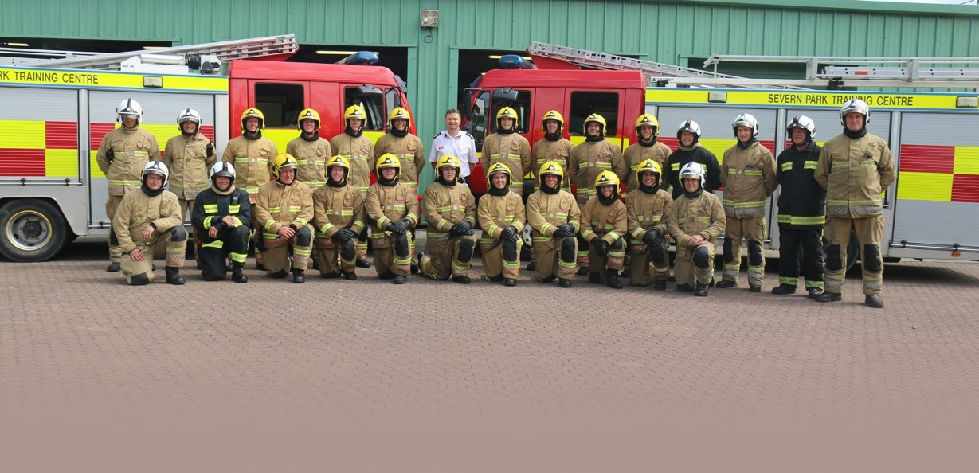
Emergency Services Environment and Sustainability Group
Faithful+Gould | David Gilbey | NZC Technical Lead | 10th May 2023

Slide 2
Salix Finance
Salix Finance summary of position:
Salix is a non-departmental public body, owned wholly by Government.
Improve Energy Efficiency
Reduce Carbon Emissions
Lower Energy Bills
Historically loans into the Public Sector but now Grant funding for fees and projects
Three iterations of the PSDS
Approaching Phase 3c
Last of this funding round
Four iterations of LCSF
Recently opened/closed
Significantly oversubscribed
Attractive as it is grant funding
Public Sector in competition
All schemes oversubscribed
Preparation is very important
Early appointments essential
Risk needs to be managed

Slide 3
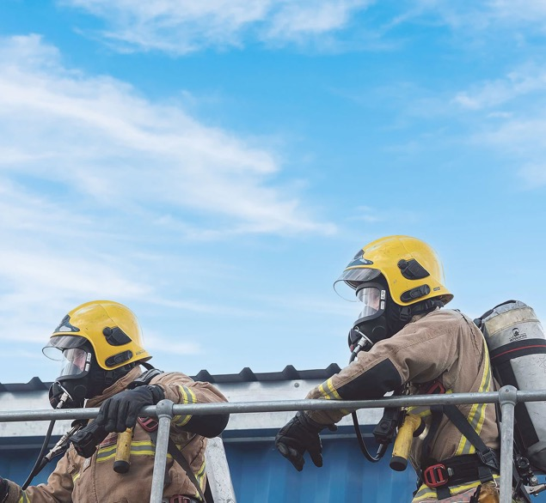
Technical Advisor – Common Issues
Cost of carbon savings below £300/tCO2e LT for Phase 3 PSDS are very unusual. Technologies that bring cost of carbon savings are likely to be queried by Salix.
Programme submitted should include contingencies for resource availability, DNO agreement, engagement with planning authority and delays in delivery of equipment.
Costs estimates should include appropriate cost contingencies (latest year-on-year inflation in UK was 5.4%*) – at least 10% for pre-tender stage applications.
Energy saving calculations and energy consumption should align with benchmarks.
Missing evidence is generally queried and not added as a compliance condition for post-tender stage.
* 19/01/2022, Consumer price inflation, UK - Office for National Statistics

Slide 4
Salix Success – Risk Register
List of risks and mitigation measures, risk level.
Risk register should include risks due to:
Resource concerns
Delays in delivery of equipment
Unforeseen increase in equipment costs
Statutory consents
DNO upgrades
Design development

Slide 5
Salix Success – Programme
Planning approval if required.
Equipment procurement timescales (typically 2-3 months for ASHPs, but judgement from engineer required).
Allowance for DNO approval (min 6 weeks).
Show when preferred contractor is to be appointed.

Slide 6
Salix Success – Commercial
Evidence to justify each cost breakdown items in form:
Design and engineering costs
Main equipment cost
Installation & commissioning cost
Project delivery cost
Contingency costs
Other project costs
VAT.
References to Spons or past projects are valid
Appropriate contingency should be allowed for (assessor to judge appropriate cost contingency). Try to include quotes – PV and heat pumps.

Slide 7
Salix Success – Like for Like Replacement
References to Spons, emails from manufacturers, quotations from previous projects or similar.
Like-for-like costs should include but are not limited to new controls, pumps, expansion vessels, pipework and insulation, cost of removing the end-of-life heating system, cost of installing the conventional heating system, commissioning work.
Quotations from contractors (including supply, installation design and other costs) confirming costs.

Slide 8
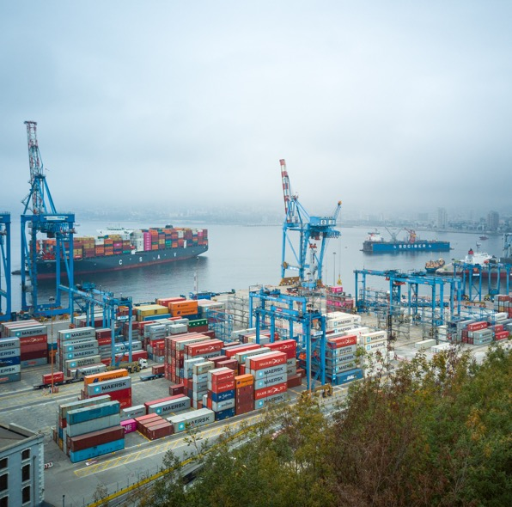
Salix Success – Procurement
Evidence to demonstrate that the procurement process is to follow compliant competition and value for money, in line with internationally and nationally agreed obligations and regulations.
8
8

Slide 9
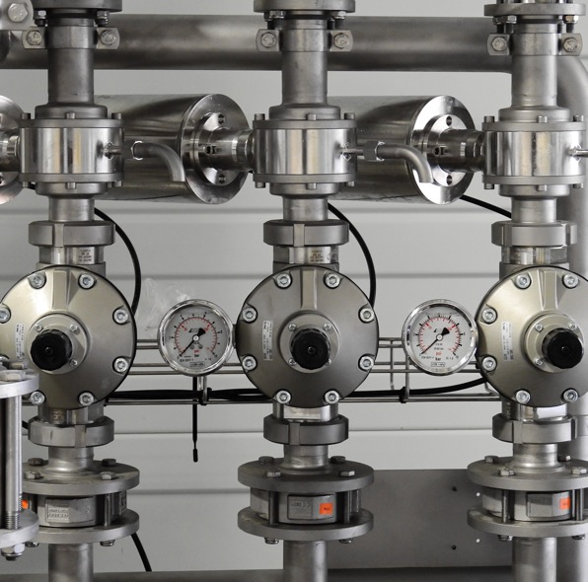
Salix Success – Measurement and Verification
Evidence to demonstrate commitment to carrying an M&V Plan (manual reading or BMS-based; if manual then how are readings going to take place when buildings are unoccupied).
CIBSE TM63 provides guidance on what an M&V plan should include.
M&V Execution Plan.

Slide 10
Salix Success – Feasibility
Feasibility study comparing a number of different technologies and stating why the proposed technologies are the most appropriate. Sufficient evidence to justify proposed technologies.
Should include clarity on decision-making and responsibilities on the applicant’s side.
Any changes after preferred contractor is on-board should align with feasibility study issued at pre-tender stage.
10
10

Slide 11
Salix Success – Organisation Chart and Schematic
Organisation chart should include applicant and contractor side
Schematic of existing system/ clear description in the application stating how the current system works.
Post contract: Detailed description of the operation of the system to be replaced.
Should include clarity on decision-making and responsibilities on the applicant’s side.

Slide 12
Salix Success – Current fossil fuel consumption
Current fossil fuel and electrical consumption/ estimation.
EPC, DEC, energy bills from a typical year (2019).
Heat loss calculations.
Energy use should align with benchmarks from CIBSE TM46 and BSRIA BG9/2011.
12

Slide 13
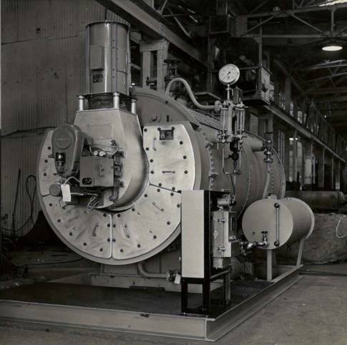
Salix Success – End of life heating system
Heating system coming to the end of its useful life.
Condition survey, Asset Register or Life Cycle Register.
Commissioning test certificate.
Service records recording boiler efficiency,
photographic evidence.

Slide 14
Salix Success – Additional supporting evidence
Additional supporting evidence depending on technologies proposed.
Carbon/ Energy saving calculations, technology specifications (product brochure), design specification (flow/return temps), O&M Manuals and heating schematics

Slide 15
Questions/Discussion

